Slide 1
A preacher, a salesman and a farmer went deer hunting.
All 3 were in their stands when they all saw the same deer and shot. They climbed down and looked for it.
When they found it all 3 said, "I shot it." "No, I shot it."
When the game warden came along he looked and said, the preacher shot it.
In unison all 3 said, "How can you tell that?"
The game warden responded, "It went in one ear, and out the other."

Slide 3
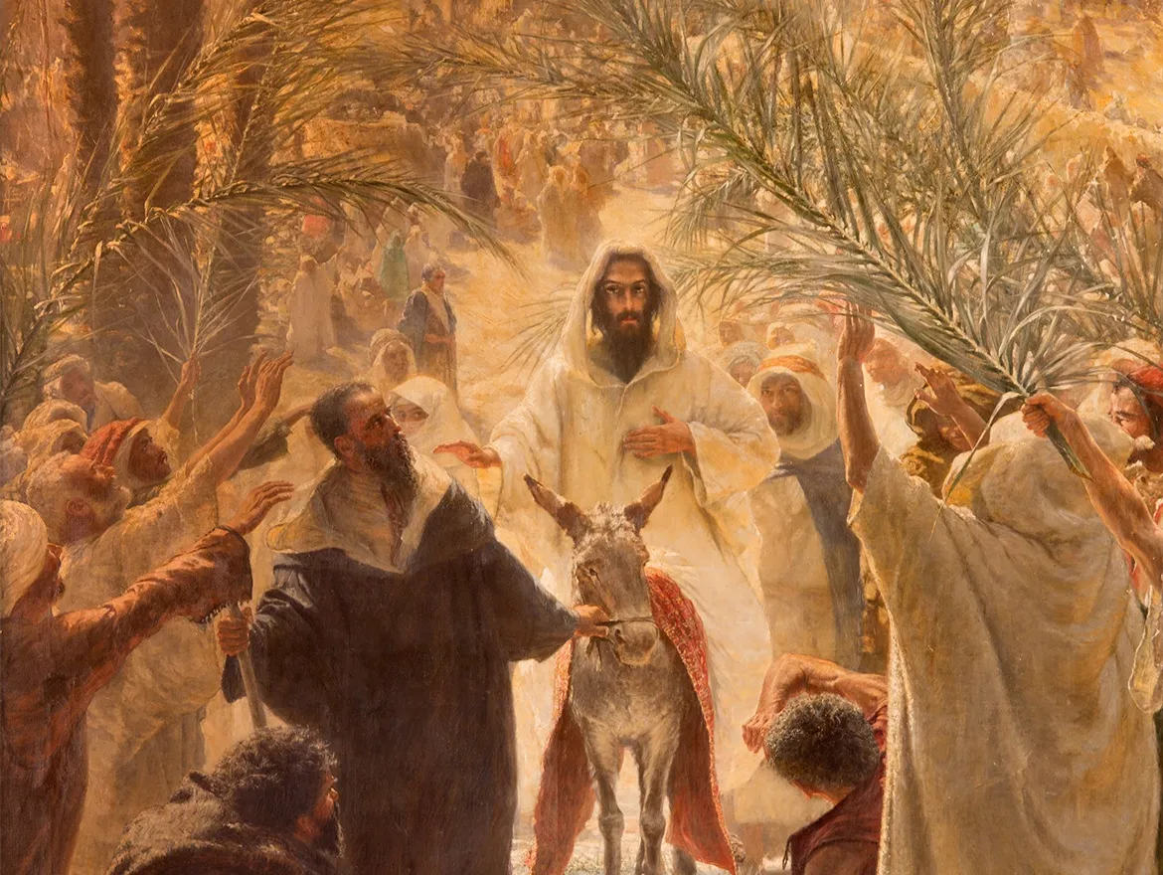
Palm Sunday
Shows Us Just How Quick…
Change Can Occur
        Life
        People
        Plans
Shows Us God Never
Changes

Slide 4
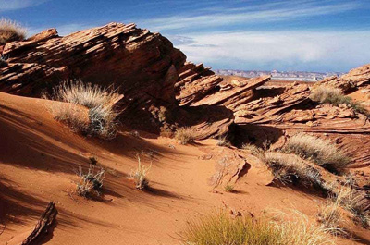
Psalm 84
Edward Christian Church
April 10, 2022
Valley of Baca
Sometimes…
You Have to Go Through…
…To Go Up pt2

Slide 5

Psalm 84:1-7 (KJV)
¹ How amiable are thy tabernacles, O LORD of hosts!
² My soul longeth, yea, even fainteth for the courts of the LORD: my heart and my flesh crieth out for the living God.
³ Yea, the sparrow hath found an house, and the swallow a nest for herself, where she may lay her young, even thine altars, O LORD of hosts, my King, and my God.
⁴ Blessed are they that dwell in thy house: they will be still praising thee. Selah.
⁵ Blessed is the man whose strength is in thee; in whose heart are the ways of them.
⁶ Who passing through the valley of Baca make it a well; the rain also filleth the pools.
⁷ They go from strength to strength, every one of them in Zion appeareth before God.

Slide 6

¹ How lovely is your dwelling place, O LORD of Heaven’s Armies. ² I long, yes, I faint with longing to enter the courts of the LORD. With my whole being, body and soul, I will shout joyfully to the living God. ³ Even the sparrow finds a home, and the swallow builds her nest and raises her young at a place near your altar, O LORD of Heaven’s Armies, my King and my God! ⁴ What joy for those who can live in your house, always singing your praises. Interlude
⁵ What joy for those whose strength comes from the LORD, who have set their minds on a pilgrimage to Jerusalem.
⁶ When they walk through the Valley of Weeping, it will become a place of refreshing springs. The autumn rains will clothe it with blessings. ⁷ They will continue to grow stronger, and each of them will appear before God in Jerusalem. Psalm 84:1-7 (NLT2)

Slide 7
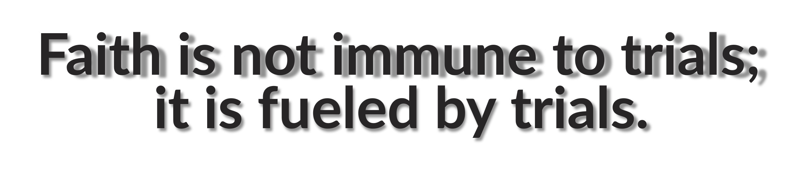
The Necessary Passage
“through the valley of Baca”
Jerusalem=
The Place to Find…
    His Presence
    His Power
    His Praise
    His Position
There Can Be No Jerusalems…
…Without Valleys

Slide 8
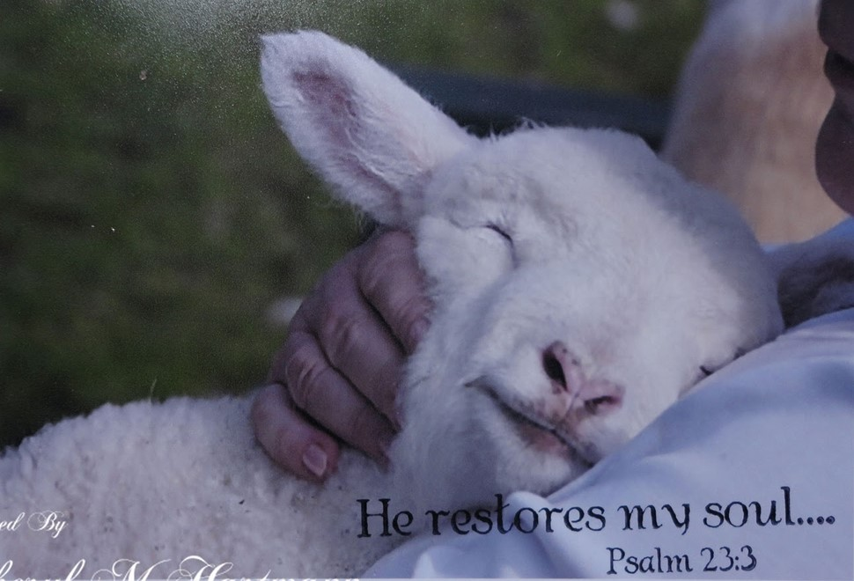
He Restores My Soul…
…Sets my Back Up on My Feet
In Your Valley…
…You Will Have His
    Presence
    Power
    Promise

Slide 9
The Necessary Passage
“through the valley of Baca”
Throughout the Ages Many had to Pass… …through the Valley of Baca
…to Get to Their Jerusalem
Moses- to see Red Sea open…
  40 years on Backside of Desert
Elijah- to see Fire Fall…
  3 1/2 years of Famine
David- to see Kingdom Restored
  Absalom- Intense Family Problems
Savior- to get to His Jerusalem
  Cross

Slide 10
The Temporary Passage
“Who passing through the valley”
Through….
No Pauses, No Layovers, No Stops, No Delays
We May Not Be Able to Avoid the Valley of
  …but the Valley Will Not Stop Us
Those Who Set Their Sights on the Mountain
…will not be Delayed by the Valley
We May Not Be Able to Avoid the Valley
  …but the Valley is only Temporary

Slide 11
The Temporary Passage
“Who passing through the valley”
Valley is Only Temporary
Psa. 30:5,“weeping may endure for a night, but joy cometh in the morning”
Psa. 34:19, “Many are the afflictions of the righteous: but the Lord delivereth him out of them all.”
Prov. 4:18,“But the path of the just is as the shining light, that shineth more and more unto the perfect day.”

Slide 12
The Transforming Passage
“make it a well”
The Peril
Distortion of the Savior-
  You’ll Accuse, Blame God, for Valley
Disbelief of the Scriptures-
  They Worked Before, No Sense Now
Despair of the Soul-
  You’ll Throw Up Your Hands and Quit
  Abandon God--Desert God.

Slide 13
The Transforming Passage
“make it a well”
Production
Change, Build, Construct
Take that Place…
…that Valley where it Appears
…You’re Going to be Defeated, Stopped,
…Conquered, Destroyed, or Die and
“Make It a Well!!!!”
Well= Spring, a Fountain, a Source of Satisfaction

Slide 14
The Transforming Passage
“make it a well”
How Do You Make Your Valley a Well?
Seek His Truth (2)
  Move Beyond Facts
  Pursue an Intimate Relationship with the Savior
Hold His Truth (4-6)
  Move Beyond Feelings
  Gain Ultimate Reality about His Kingdom
Let His Truth Hold You (10-11)
  Move Beyond Flesh
  Desire Passionate Revelation of His Nature

Slide 15
The Transforming Passage
“make it a well”
Why does God Permit the Valley of Baca?
Our Good:
  Each Time You are Called Upon to…
…Walk Through Trouble,
…You Come Out Better
Our Growth:
  When We Walk the Path of Suffering,
…We Draw Closer to God.
Others Guidance:
  We Cannot Lead Others Where…
  … You Have Not Been

Slide 16
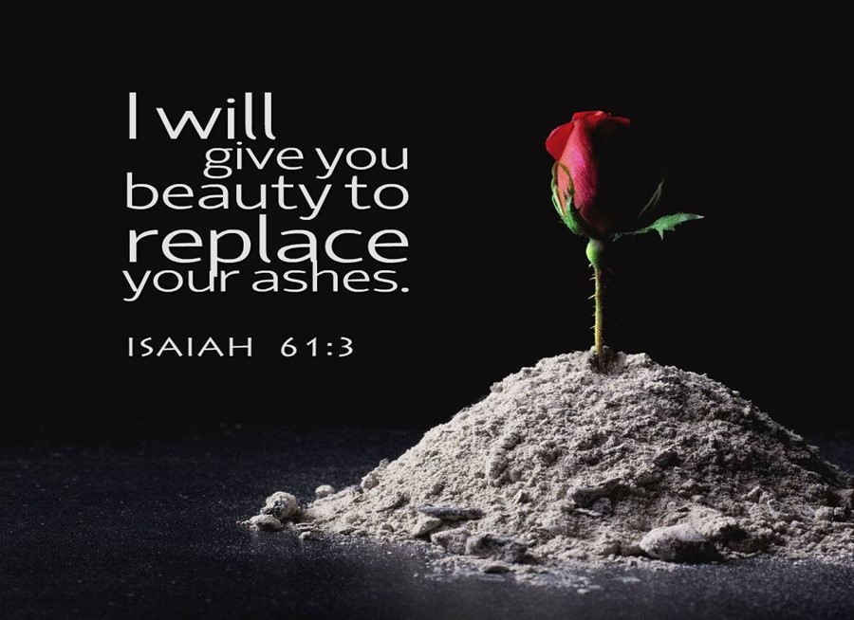
The Transforming Passage
“make it a well”
Isaiah 61:3 (KJV)
³ To appoint unto them that mourn in Zion, to give unto them beauty for ashes, the oil of joy for mourning, the garment of praise for the spirit of heaviness; that they might be called trees of righteousness, the planting of the LORD, that he might be glorified.

Slide 17
Video #
The Mountain of God

Slide 18
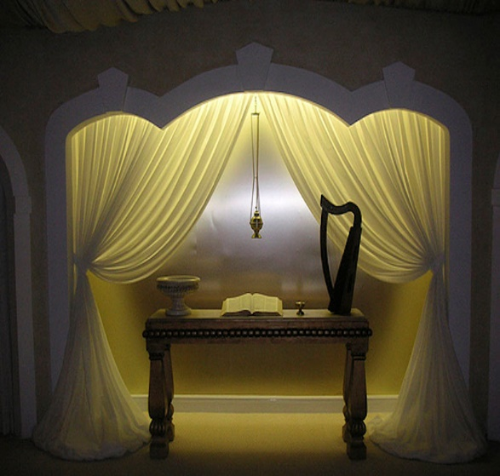
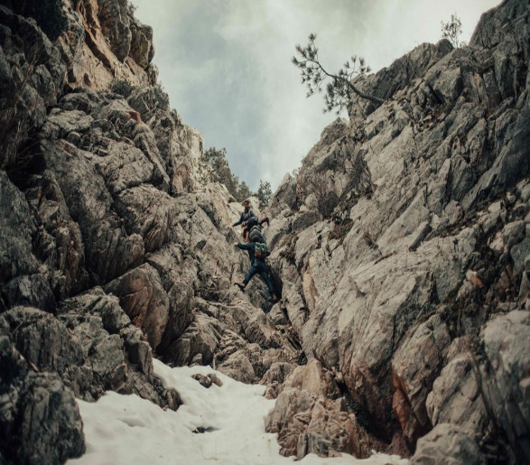
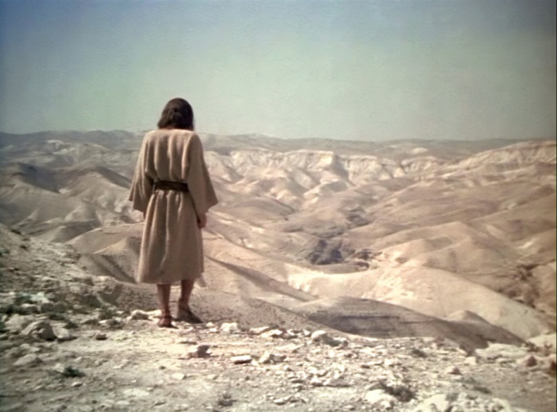

Slide 19
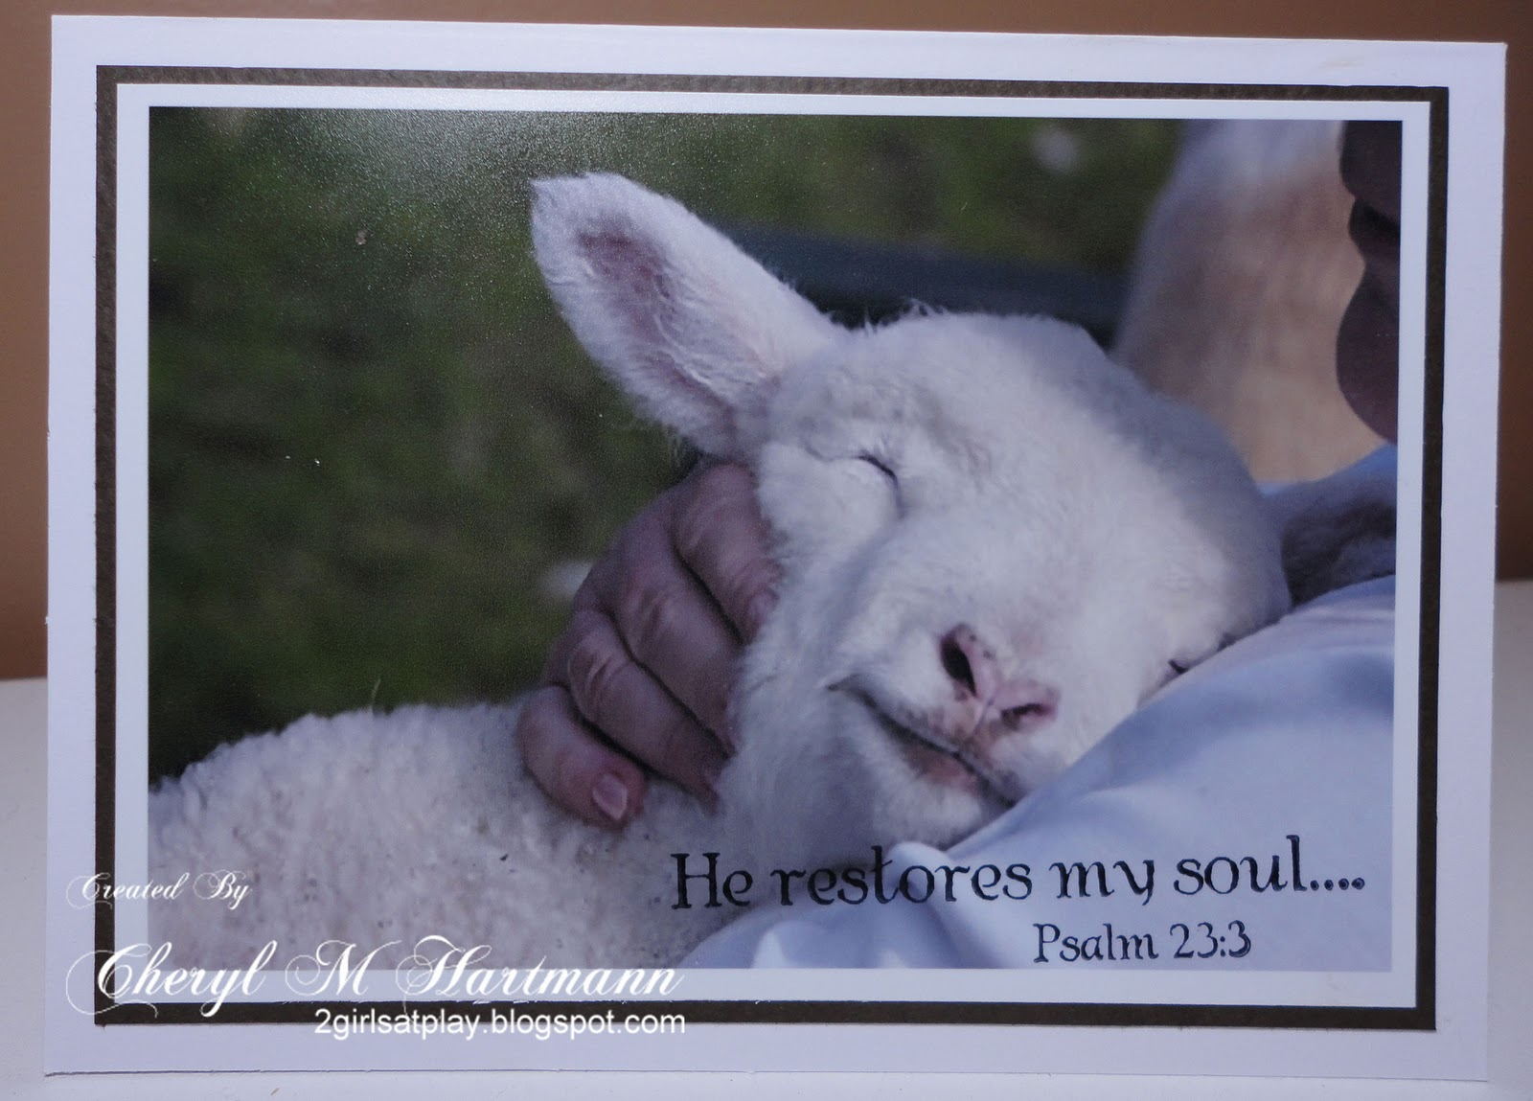
In Your Valley…
…You Will Have His
    Presence
    Purpose
    Promise

Slide 21
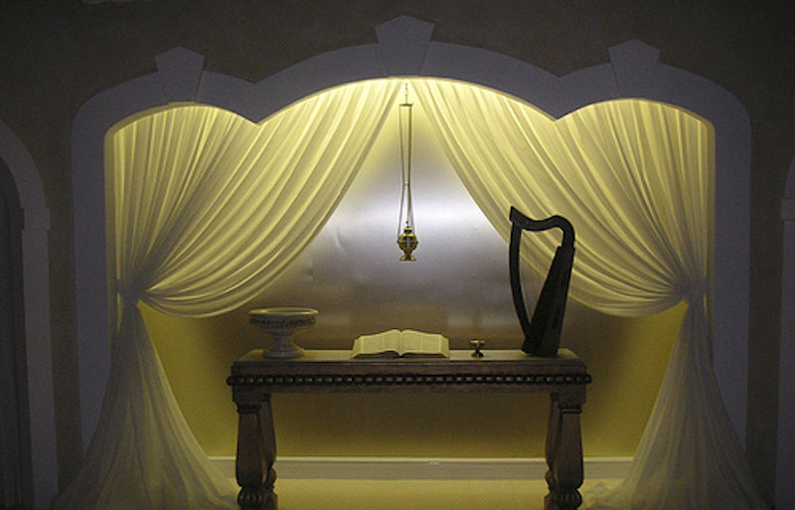
The Place of the Tabernacle
It is a Place Of…
Great Beauty and is Well Beloved (1)
“How amiable are thy tabernacles..!”
Desire and Worship (2)
“My soul longeth..fainteth..heart..flesh crieth out.”
Nesting and Sacrifice (3)
“Yea, the sparrow hath found an house, and the swallow a nest for herself, where she may lay her young, even thine altars”

Slide 22

The Place of the Tabernacle
It is a Place Of…
Great Beauty and is Well Beloved (1)
Desire and Worship (2)
Nesting and Sacrifice (3)
Continuance and Glory (4)
“Blessed are they that dwell in thy house: they will be still praising thee. Selah.”
Blessing and Strength (5)
“Blessed .man whose strength is in thee; ..heart are ways of them.”

Slide 23
The Path to the Tabernacle
God’s City was:
  Situated on a Hill
  Surrounded by Valleys
The Only Way to Go Up…
…was to Go Through

Slide 24
Jerusalem Surrounded by Valleys
Rephaiam- Shadows
  Valley of Giants
  Stitch -Heal
Hinnom- Wailing
  Satan Seemed To Win
  Trash Heap
Baca- Weeping
  Trapped
  Despair
It Can Be a Place and/or Condition

